Slide 1
Board Chair Report
June 27, 2024

Slide 2
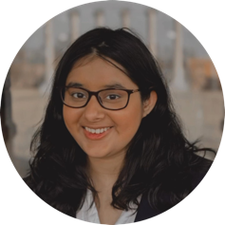
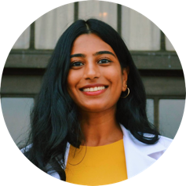
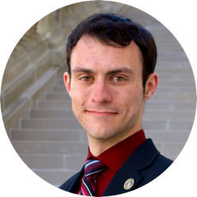
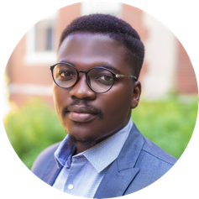
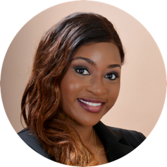
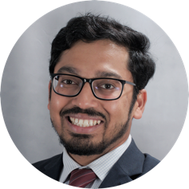
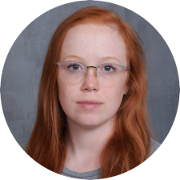
Remington R. Williams Award Recipients
Vishvi Aurora Biological Sciences and Physics
Rithika Ginjupalli Medical Doctorate
Ryan Highfill Civil Engineering
Damilola Oduolowu Journalism
Okunsogie Jessica Osaze Health Informatics
Teja Teppala Physics
Angela Truesdale Accounting

Slide 3
Call to Action – Today's Discussion
Board of Curators, President and Chancellors: Discuss how we take the University of Missouri System forward, set the pace to compete in the dynamic and evolving landscape of higher education, and continue to show the value we deliver.

Slide 4
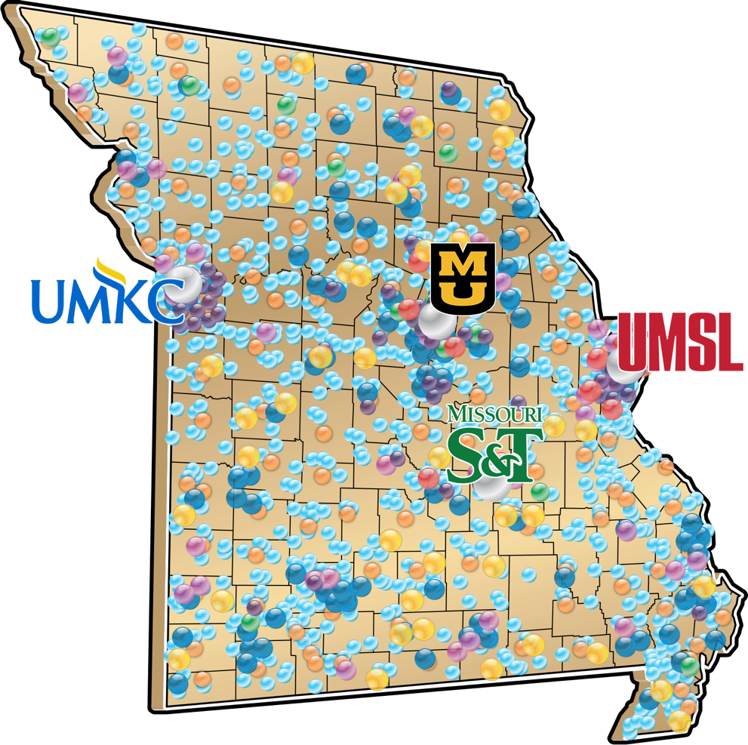
We are Missouri, Missouri is us.
Notes:
We can keep adjusting this

Slide 5
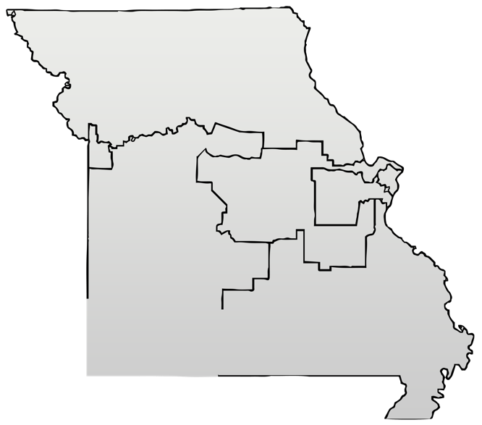
Area Involvement – Southwest Region
2,000+
Students
10,000+
Alumni
3,000+
Patients Treated
133,000+
MU Extension Educational Contacts

Slide 6
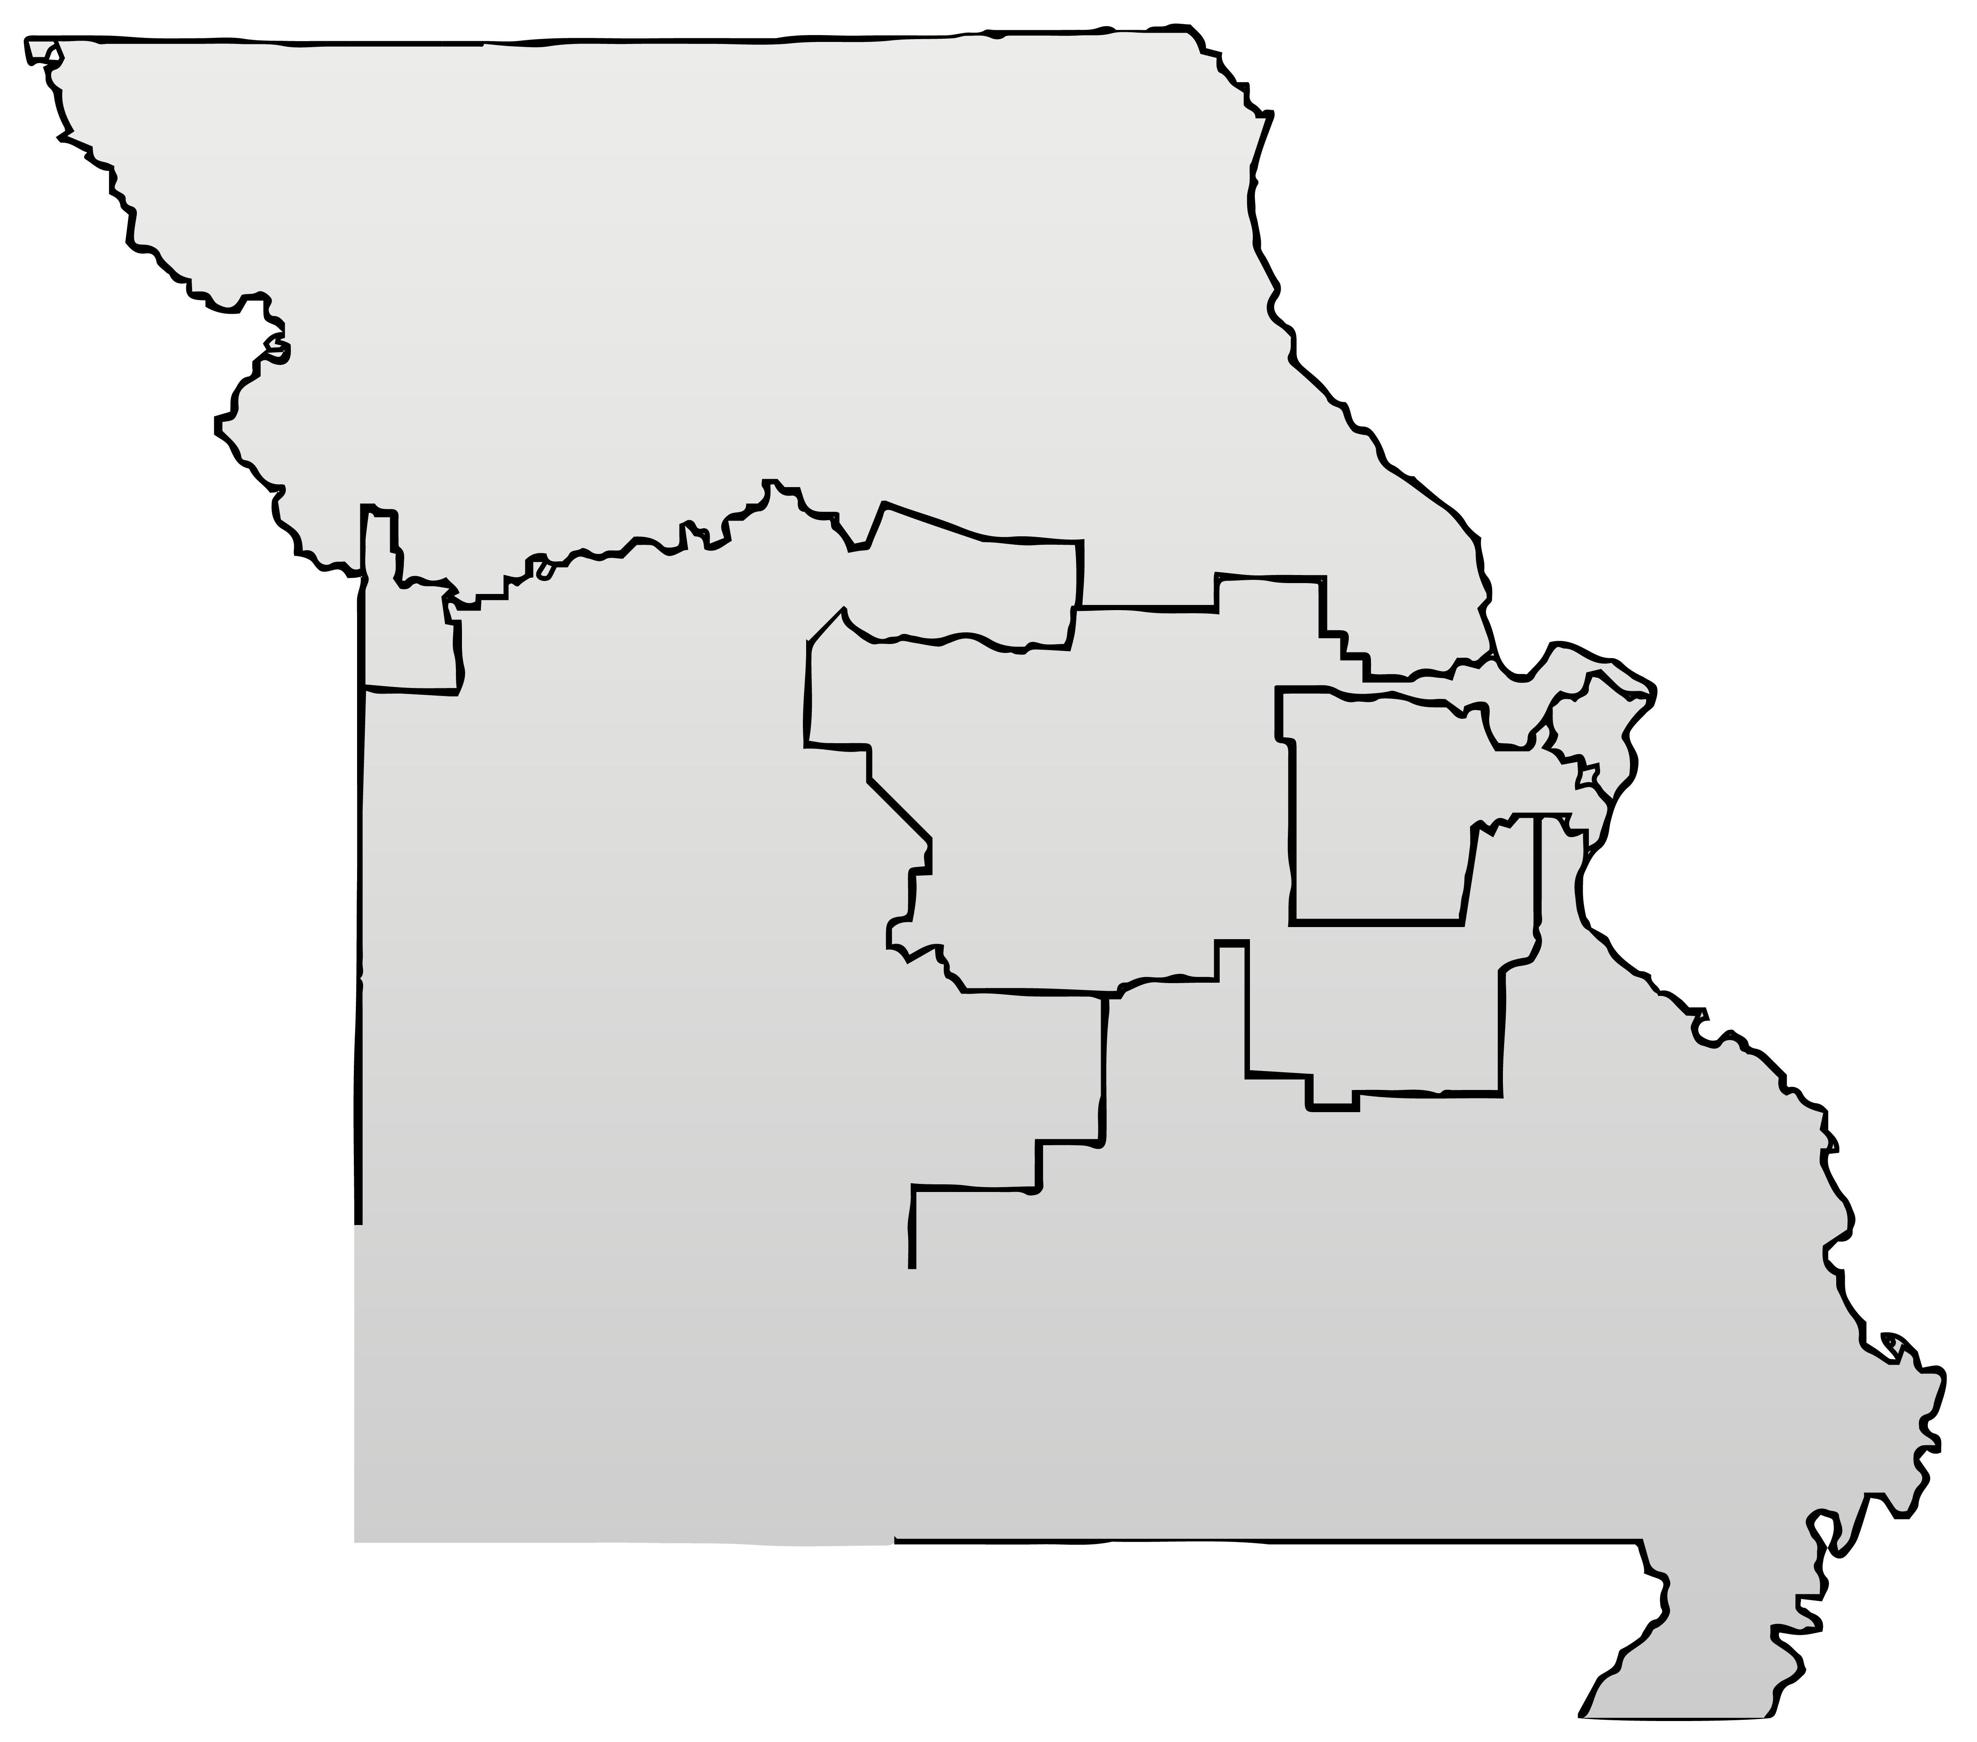
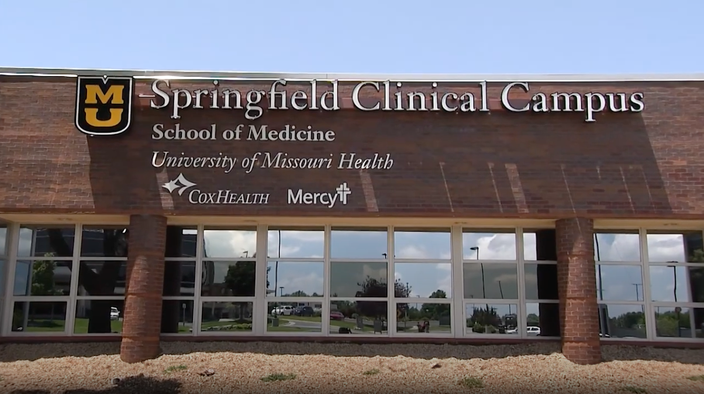
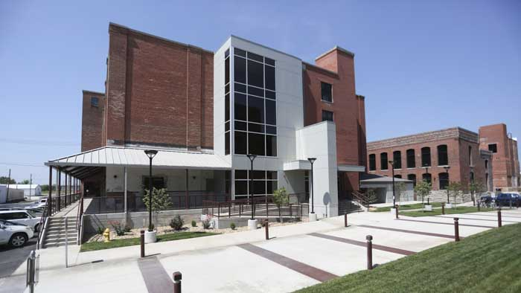
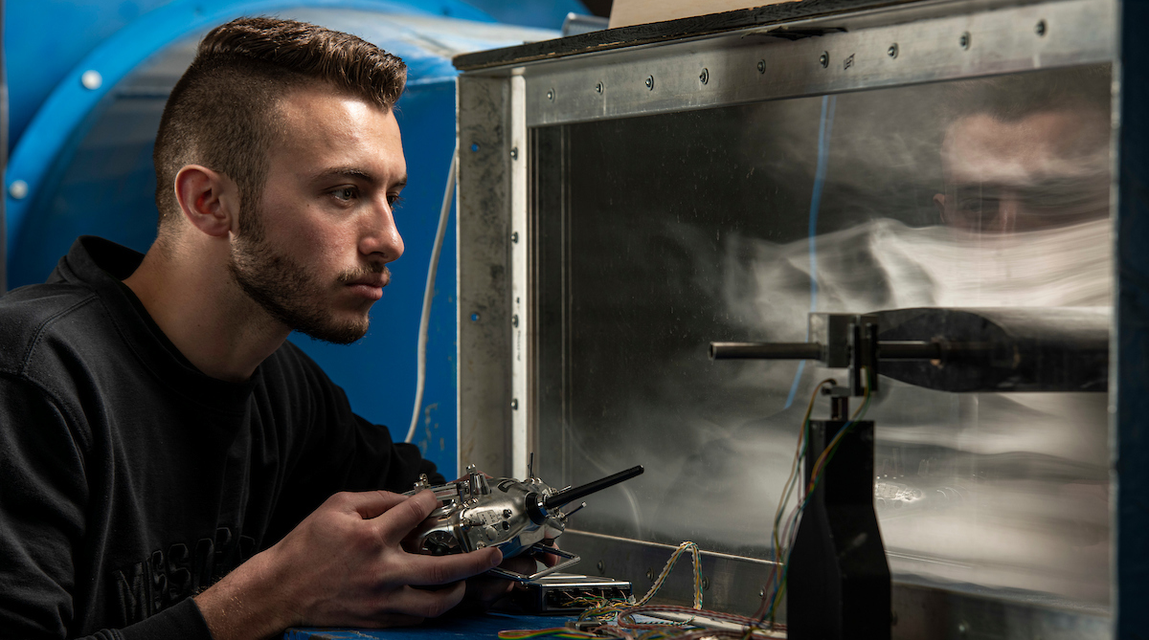
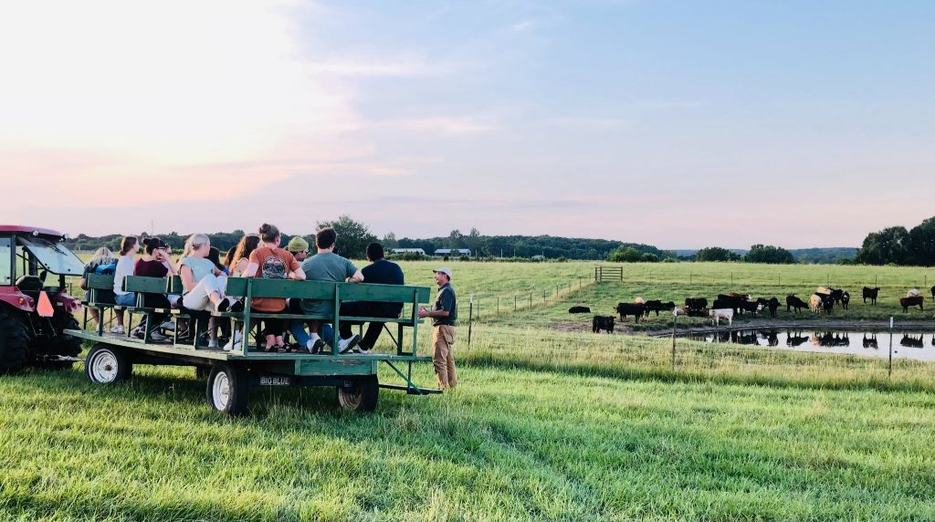
Area Involvement – Southwest Region
v
v
v
v
v
MU School of Medicine – Springfield Clinical Campus
Since 2016, this clinical campus has held over 350 physicians serving as MU faculty members.
UMKC – School of Pharmacy Satellite Campus
Classes are held in Brick City, a Missouri State University space.
UMSL – Partnership with Missouri Institute of Mental Health
MIMH partners with Community Partnerships of the Ozark out of Springfield to implement substance misuse prevention programming using funding through the Department of Mental Health.
Missouri S&T – Cooperative Engineering Program
The most sought after degree program at Missouri S&T allows MSU students and others to pursue S&T’s mechanical engineering bachelor’s degree program without traveling to the Rolla campus.
MU Extension – Southwest Research, Extension and Education Center
This 893-acre research site serves 22 counties and addresses the main agricultural concerns of area industries: beef, forage and horticultural crop production.

Slide 7
Missouri Momentum
Notes:
We can keep adjusting this

